Slide 1
Practical guide
LLP & Erasmus + Programmes

Slide 2
Weather in Spain
The summers are very hot.
Temperatures in August may exceed 40 ⁰ C
It is very important to drink a lot of liquids in the summer period.
Spring and autumn are usually very short and temperature flactuations quite significant.
In winter in the south of Spain temperatures normally never fall below - 1 ⁰C, but the temperature is quite low.
Please, be prepared for a lot of rain, humidity and low temperatures in the winter.
LLP & Erasmus + Programmes

Slide 3
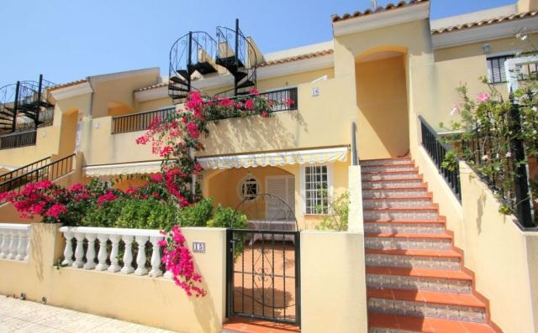
Spanish houses
They are constructed in order to keep the warm out and not keep it in.
Floors are covered with tiles or marble to give the cooling sensation during the summer.
In winter, such floors cause a feeling of coolness.
Some of the rooms look out onto interior patios which are not so well lit like the rooms looking out onto the exterior streets.
LLP & Erasmus + Programmes

Slide 4
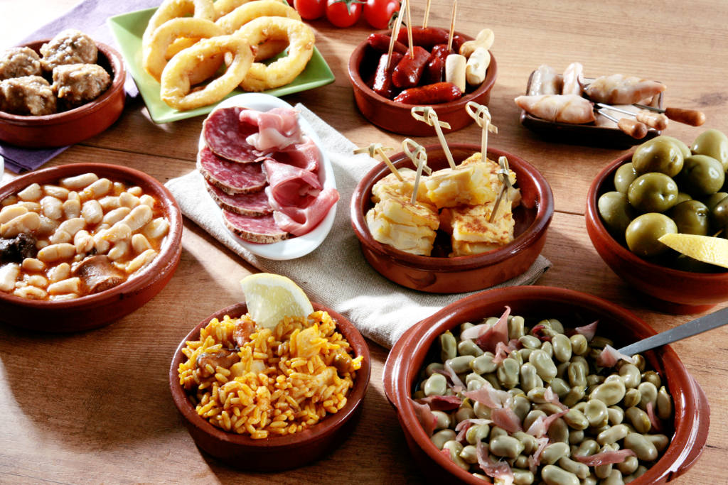
Spanish cuisine
There are quite large differences compared to the rest of Europe.
It is a cuisine rich in seafood. However, you do not have to worry: usually it is not served by us or the host families, unless at the request of the participant.
In Spain, it is very typical to go on ´tapas´ – these are small portions of food, consumed with a drink in bars.
For dressing salads are used olive oil and vinaigrette.
Many dishes are served cold, for example a cold tomato soup, called 'gazpacho' or a potato salad with tuna and sweet corn.
Spanish people eat a lot of dishes deep fried in olive oil.
LLP & Erasmus + Programmes

Slide 5
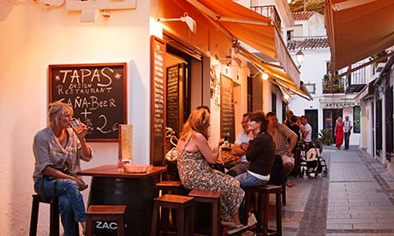
Spanish lifestyle
Spanish people spend a large part of their free time outside – and the atmosphere is particularly lively during the parties called ´fiesta´.
On warm evenings, street bars and cafes are filled with people who want to rest and relax.
Life in Spain goes slower than in the rest of Europe, especially in the south.
LLP & Erasmus + Programmes

Slide 6
Siesta and silence at night
According to Spanish law, the hours of silence are between 2 p.m. a 5 p.m. and between 11 p.m. and 8 a.m.
In cases of non-observance of hours of silence, neighbours can call the police to intervene.
A police call means a fine of € 600 to € 12,000.
Please respect the hours of silence and do not make a noise.
In case of police intervention, participants who do not follow the rules will be checked out from the place of accommodiation.
LLP & Erasmus + Programmes

Slide 7
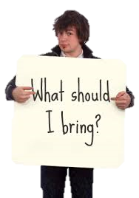
What should I bring?
In the summer period:
Light, airy clothing,
Flip-flops for the swimming pool and to walk over the residence,
suncream with a high SPF (Sun Protetcion Factor),
beach towel,
hat/cap.
In the winter period:
warm clothing,
long-sleveed warm pijamas,
warm slippers,
warm cup,
scarf,
warm coat or jacket,
umbrella.
LLP & Erasmus + Programmes

Slide 8
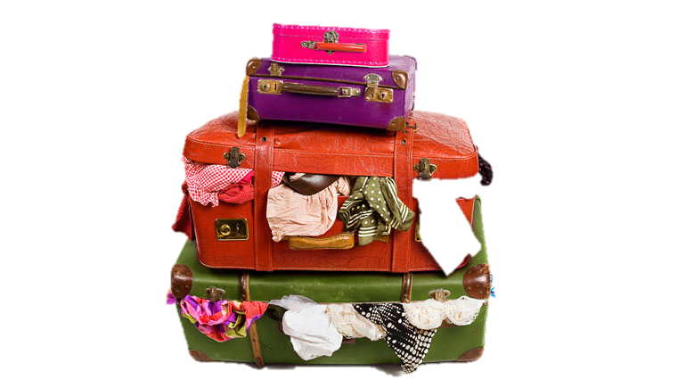
What else will I need?
Laptop or tablet
As all of our accommodation have an access to Internet, it is a good idea to bring your own laptop or tablet.
Adaptors
The UK & Irish trainees can’t forget to bring adaptors with them for their plugs.
Power bank
Intensive photographing and recording movies during the trips quickly makes battery running low in your phone, so get your power bank with you and you will never run out of energy.
LLP & Erasmus + Programmes

Slide 9
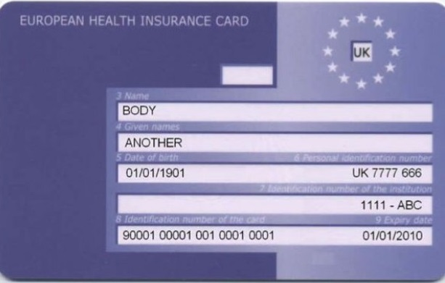
Healthcare in Spain
Nationals of EU countries can get free medical treatment in Spain upon showing the valid European Health Insurance Card.
Please do not forget to bring it with you. Otherwise, the waiting time for the doctor will be longer, and some clinics may refuse to accept the patient.
LLP & Erasmus + Programmes

Slide 10
Money & Banks
There are many banks in Seville, Malaga and Ubeda. The names of some of them are: Unicaja, Caja Rural, Santander, ING Direct, etc.
You can withdraw money from any ATM. However, when using ATMs you need to check what kind of fees are charged (as they may fluctuate between, depending on the bank system, usually oscillate around 2 Euros).
LLP & Erasmus + Programmes

Slide 11
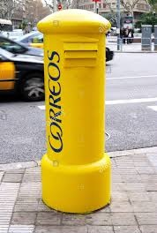
Post office
Opening hours:
Monday - Friday : about 2 p.m. - 2:30 p.m. Saturdays: about 12:30 p.m. - 1 p.m. Sundays: closed
To send a postcard or a letter, you can buy a stamp at the post office or at any kiosk.
The European Union stamp costs 1,5€.
Mailboxes can be found in many places, so if you do not need to send a parcel or a registered letter, you can simply drop a letter with a stamp into one of the boxes.
LLP & Erasmus + Programmes

Slide 12
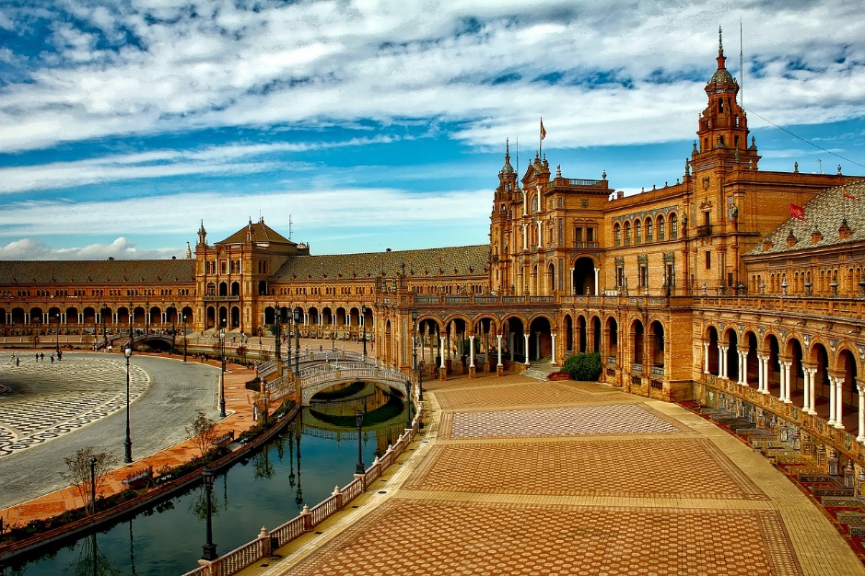
Seville
LLP & Erasmus + Programmes

Slide 13
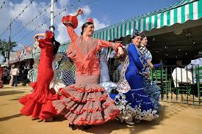
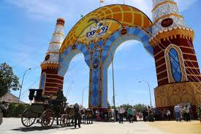
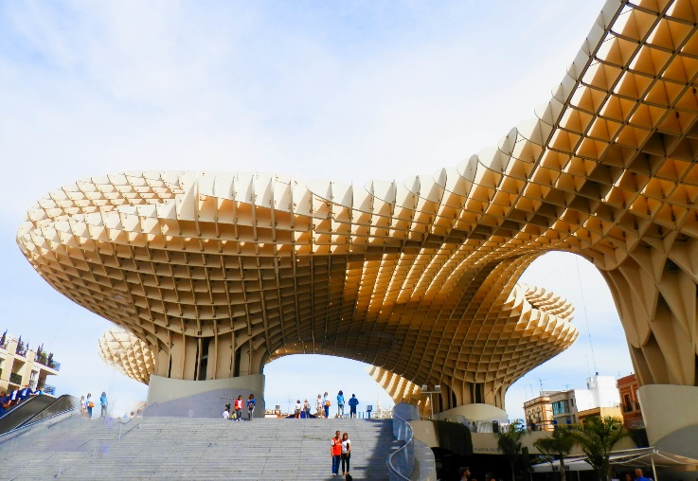
Entertainment
The Andalusian capital delights with the joy, hustle and bustle of all the streets and squares of the old town. Here is an interesting complex of buildings inscribed on the UNESCO World Heritage List and the folk areas of Triana and La Macarena. Sevilla was in the past a reloading port for all ships returning from both Americas. You can meet exotic plants and parrots brought from South America.
LLP & Erasmus + Programmes

Slide 14
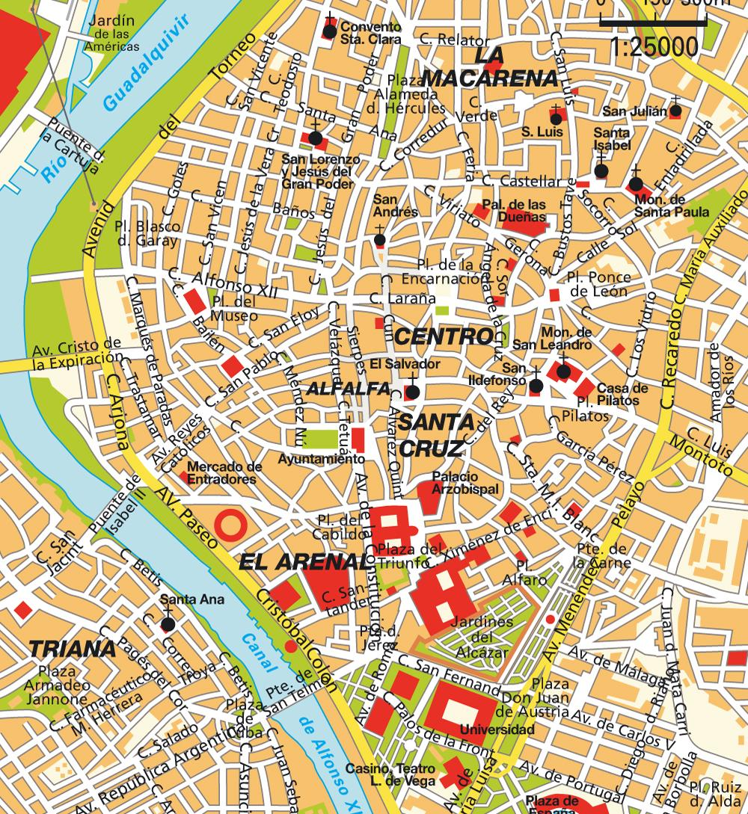
Seville Old Town
Below is a list of the most important places and monument to visit in Sevilla:
El campanario de la Giralda
Los Reales Alcázares
La Cathedral
La Torre de Oro
Plaza de España
LLP & Erasmus + Programmes

Slide 15
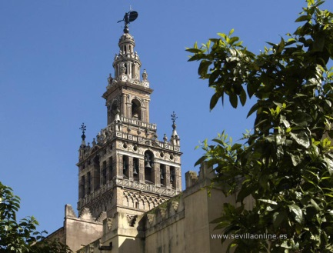
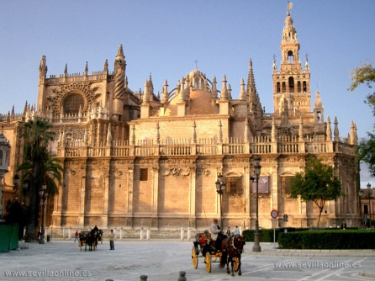
Monuments of the Old Town
La Cathedral
The Cathedral of Seville is one of the largest cathedrals in the world. It was built in the years 1402-1506 on the site of an old 12th-century mosque. The magnificent interior of the cathedral is the tomb of Christopher Columbus, and the climb to the Giralda bell tower, which was once a minaret, remain in our memory for a long time, because from its top there is a magnificent view of the entire city.
LLP & Erasmus + Programmes
El campanairo de la Giralda
Belfry of the cathedral, which initially functioned as a minaret. In 1987, the Cathedral with the Alcázar and the Central Archives of India was included in the UNESCO World Heritage List

Slide 16
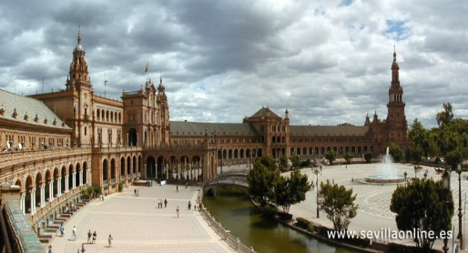
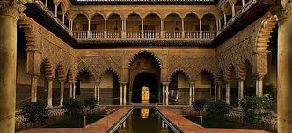
Monuments of the Old Town
Plaza de España
(in Spanish, "Plaza de España") it was created in the Maria Luisa Park in 1928, especially for the Ibero-American exhibition, designed by Aníbal Gonzáles. The building was created in the neo-mudejar style with art deco elements.
LLP & Erasmus + Programmes
Los Reales Alcázares
The royal palace in the style of mudejar, whose origins date back to the 11th century, when the representatives of the Arab Cordobian caliphate resided here. The building contains many rooms, patios and gardens.

Slide 17
Malaga
LLP & Erasmus + Programmes

Slide 18
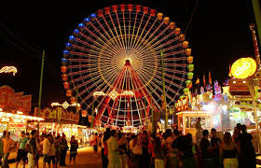
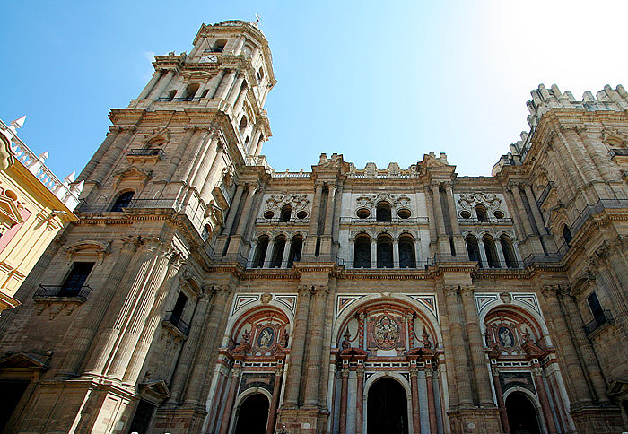
Entertainment
Malaga is famous especially for its beautiful weather! About 300 days a year the sun shines here. In addition, for history lovers, important points will be the castles, cathedrals and palaces created in the style of mudejar, which is a combination of Arabic and Christian architecture. In the first half of August, the Feria de Malaga Festival begins here, lasts a week and attracts tourists from all over Europe.
LLP & Erasmus + Programmes

Slide 19
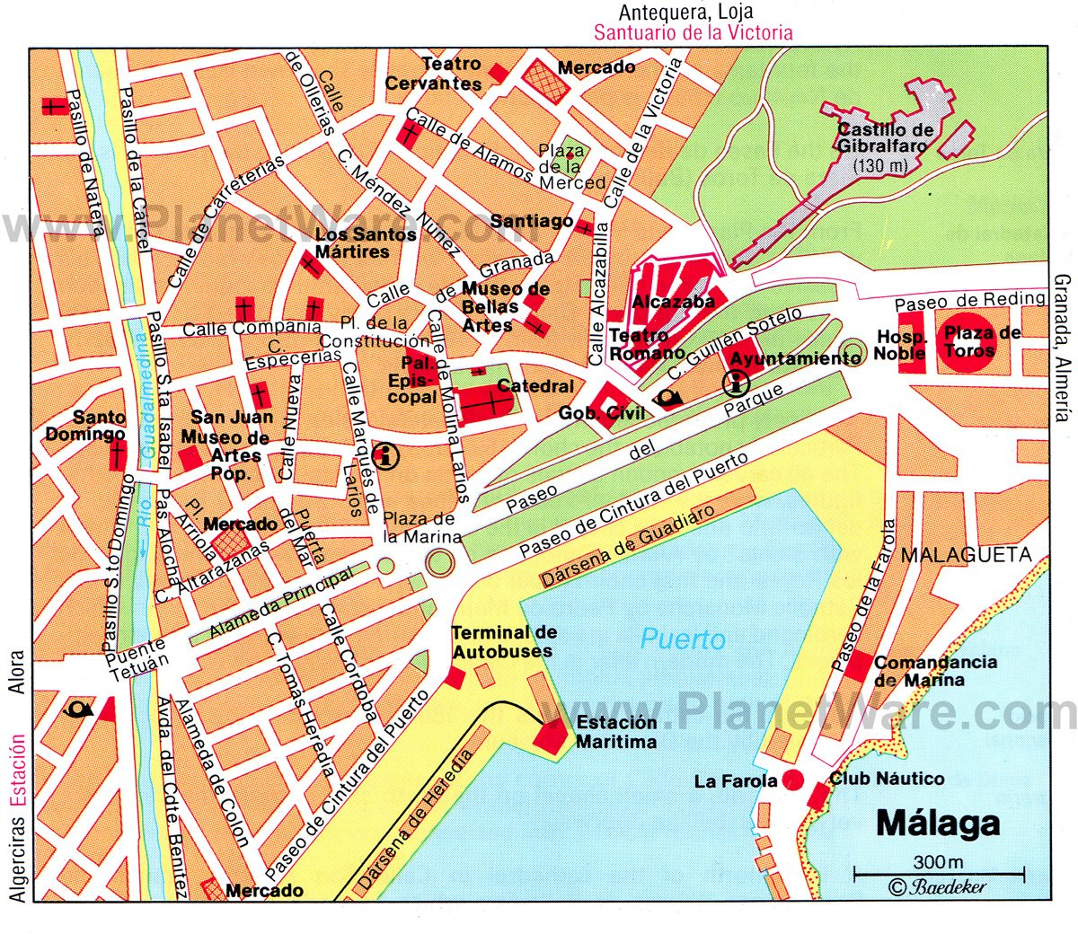
Malaga Old Town
Below is a list of the most important places and monument to visit in Malaga:
El Palacio Aduana
Mirador de Gibralfaro
Plaza de la Merced
Teatro Romano
Alcazaba
Gibralfaro
Catedral
Playa la Malagueta
Parque
LLP & Erasmus + Programmes

Slide 20
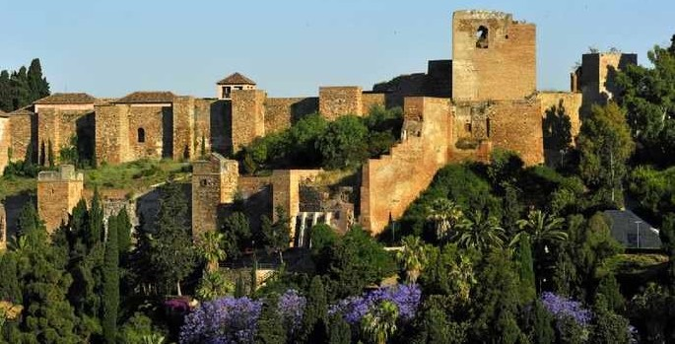
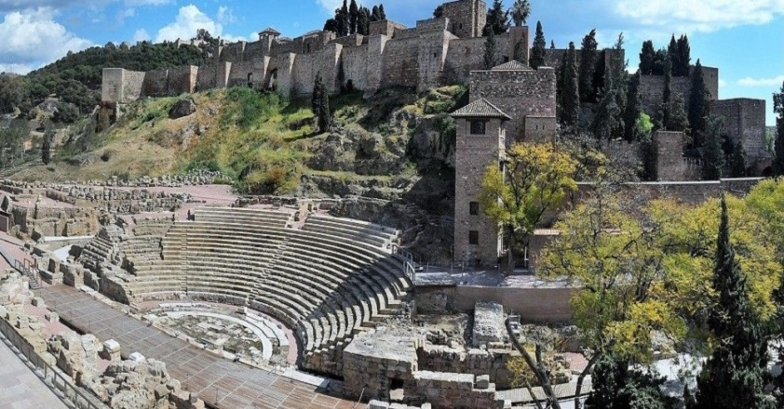
Monuments of Old Town
Teatro Romano
Located in the heart of the city, below the Alcazaba fortress, the Roman Theater is the oldest monument in Malaga. It was built in the first century BC and was used until the 3rd century AD. After taking over this area in the 8th century, the Moors demolished part of the theater, and the obtained stone was used to build the fortress. To this day, Roman columns and capitals can be seen in the Alcazaba. Over time, the theater was forgotten and buried underground. There he remained for almost five centuries.
LLP & Erasmus + Programmes
Alcazaba and Gibralfaro
Above the theater rises the aforementioned Alcazaba. The walls of Gibralfaro are even higher. Both objects were built by a Muslim. Alcazaba is a fortress built in the eighth century on Roman ruins, and its main goal was to protect the city from pirate attacks.

Slide 21
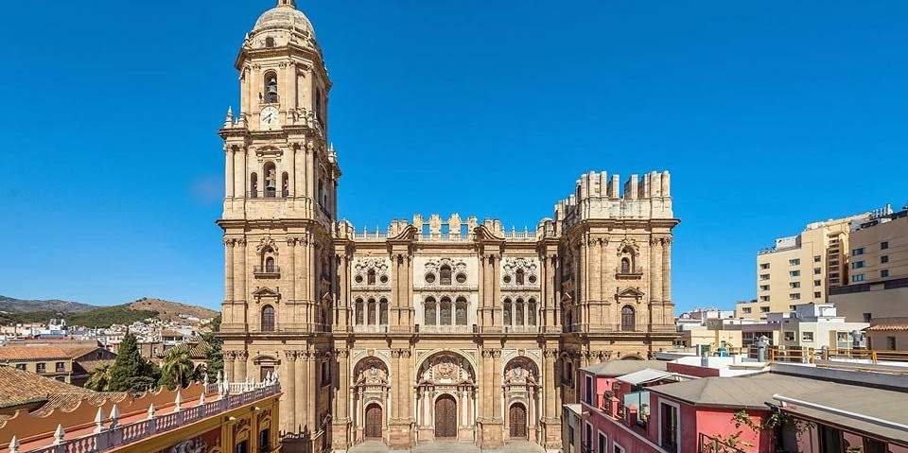
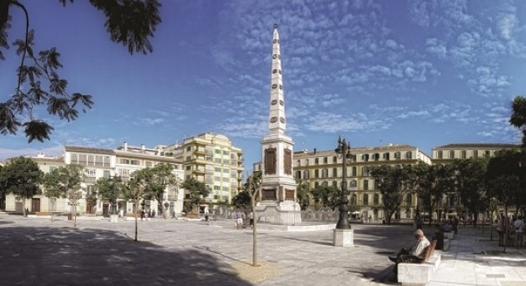
Monuments of Old Town
Plaza de la Merced
This is one of the larger squares of Malaga, which is known primarily because it is near the Picasso family home. They say it was in this square where the famous artist made his first steps. The Picasso Museum is also nearby.
LLP & Erasmus + Programmes
Catedral
A short distance from the castle hill, in the heart of the city, is the Cathedral of Malaga. This is the second tallest cathedral in Andalusia, just after the Seville Giralda. At the beginning, the project assumed the construction of two towers, but due to the lack of sufficient financial resources, the second tower was never completed, which is why the cathedral is called the One-Handed Lady - "La Manquita".

Slide 22
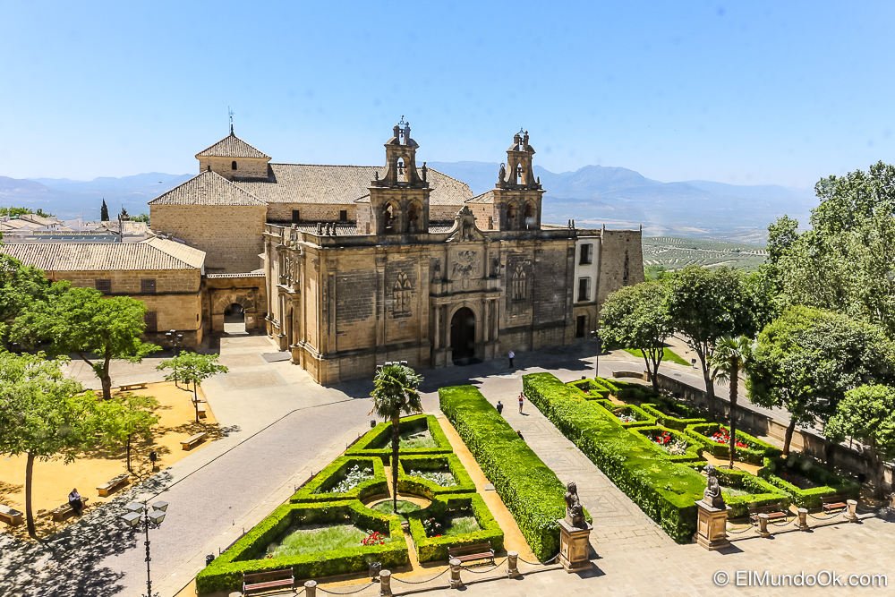
Ubeda
LLP & Erasmus + Programmes

Slide 23
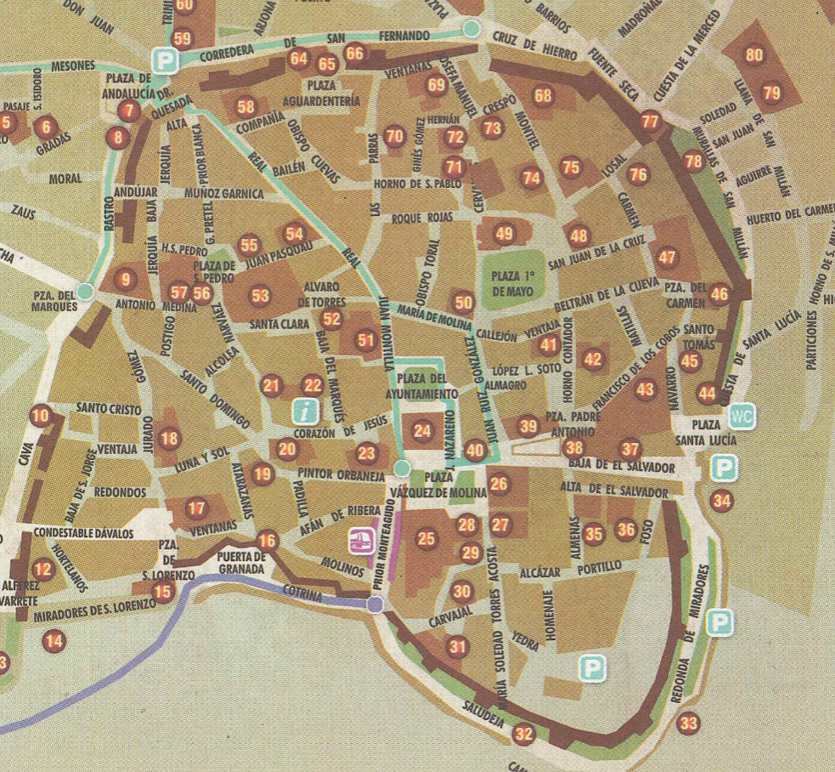
Ubeda Old Town
Below is a list of the most important places and monuments to visit in Ubeda:
Hospital de Santiago
Iglesia de San Pablo
Capilla de San Salvador
Paredes de la ciudad
LLP & Erasmus + Programmes

Slide 24
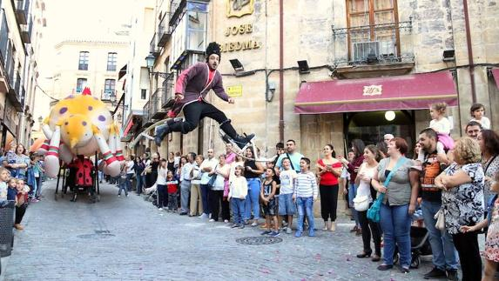
Entertainment
Ubeda is a beautiful town located on the hill called La Loma. A magnificent view of the olive fields surrounding the hill makes the walk itself a wonderful experience. At the turn of September and October Fiesta San Miguel takes place. During the festival in Ubeda there are organized flamenco dance performances and local fairs. In Ubeda in mid-September there is also a Feria de la Tapa. We recommend this event, not only because of the festive and joyful atmosphere, but also because of the opportunity to taste many traditional Spanish tapas, especially those from Ubeda.
LLP & Erasmus + Programmes

Slide 25
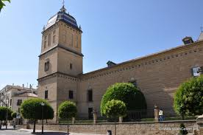
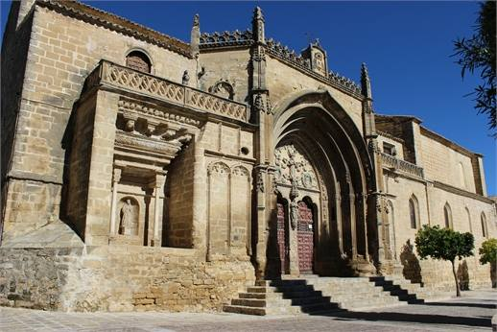
Monuments of Old Town
Hospital de Santiago
The building was not only a church, pantheon and palace, it was also used to help the poorest patients. Currently, various types of cultural events take place there: concerts, exhibitions, chess competitions or conferences (on the right).
LLP & Erasmus + Programmes
Iglesia de San Pablo
Built in the fourteenth century, although the building in a state in which we can admire it now, was built in the sixteenth century. (on the left).

Slide 26
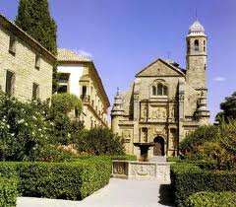
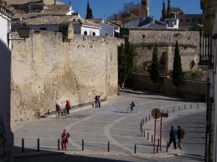
Monuments of Old Town
Capilla de San Salvador
The most famous building in Ubeda - and one of the best examples of the Spanish Renaissance in architecture, as well as one of the most ambitious examples of the private religious architecture of the Spanish Renaissance, which was to serve as a funeral chapel (photo on the left).
LLP & Erasmus + Programmes
Paredes de la ciudad
Ubeda's defensive walls played a very important role due to their strategic location, i.e. near the border with the Arab kingdom of Granada. The chronicles of those years describe Ubeda as the most powerful city of Andalusia. The city has preserved many fragments of walls that were built - and rebuilt in the period between the 9th and 14th centuries.

Slide 27
Spanish style What can surprise you?
Spain is a country of contrasts and fantastic people.
Being aware of cultural differences will let you feel comfortable here, and your stay will be very successful.
LLP & Erasmus + Programmes

Slide 28
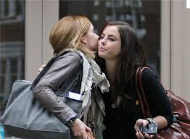
Muuuah! Don’t panic!
Spanish people are definitely relaxed and open for new relations. Their habit is to give each other two kisses on the cheek to greet. Children, young people, adults, family, friends and completely unknown people kiss each other.
LLP & Erasmus + Programmes
Remember that when someone presents you, you should answer "encantado" what can be translated as "nice to meet you".

Slide 29
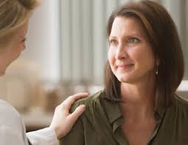
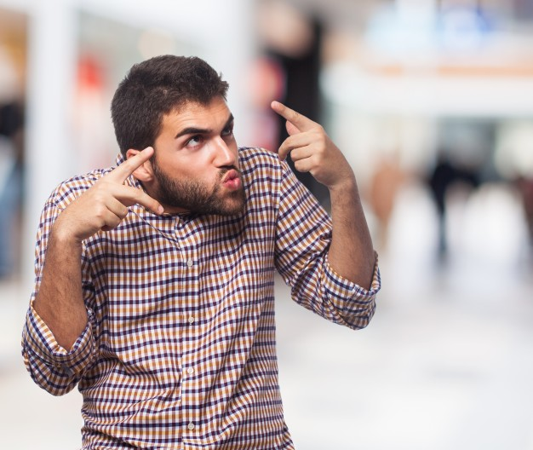
Gestures & pats
Patting or touching the caller is much more socially allowed in Spain than in other countries.
Spanish people speak loudly, they often exclaim and constantly make gestures.
These are some of the cultural differences that foreigners notice being first time in contact with Spanish people.
LLP & Erasmus + Programmes

Slide 30
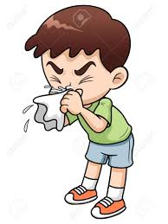
JEZUS?!
Do not be surprised that when you sneeze, someone will tell you Jesus. This is the Spanish equivalent of „bless you”.
LLP & Erasmus + Programmes

Slide 31
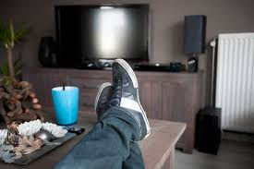
Shoes at home?
Contrary to the Polish tradition of taking off shoes right immediately after entering the house ... in Spain this custom does not apply.
You may fill your hosts with consternation by leaving your shoes in the hallway.
LLP & Erasmus + Programmes

Slide 32
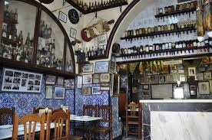
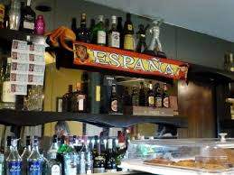
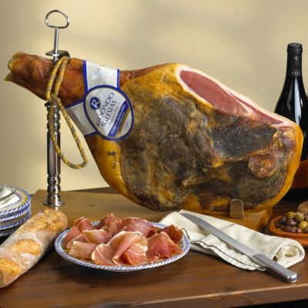
The dirtier, the tastier
Typically Spanish bars and restaurants are always full of people who make a lot of noise and mess.
Europeans are always shocked by one thing - A BIG MESS. But please, don’t get discouraged. Experts say openly - the bigger the mess, the better the restaurant.
LLP & Erasmus + Programmes

Slide 33
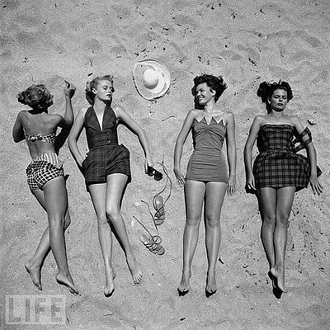
¡Qué Guapaaa! ¡Qué Dios bendiga a tu madre!
The Spanish tend to loudly express their opinions about women, even strangers.
Do not feel offended if you hear on the street something about you.
They opinions are usually positive and express their appreciation.
LLP & Erasmus + Programmes

Slide 34
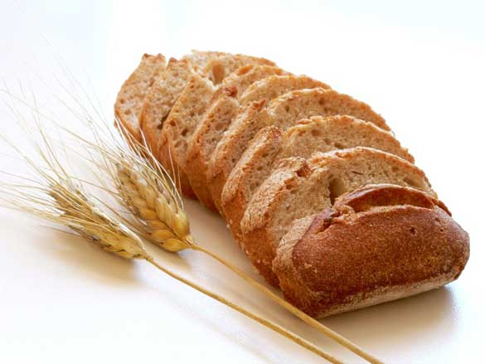
El pan - bread
Bread is eaten absolutely with everything: rice, potatoes .. and even with pasta.
LLP & Erasmus + Programmes

Slide 35
Emergency Numbers
euroMind
+34955220923 - Sevilla +34 656586430 - Malaga +34 654807859 - Ubeda
Police/ Ambulance/ Fire Brigade / Health Service -Emergency number : 112
LLP & Erasmus + Programmes

Slide 36
Thank you euroMind team ☺
LLP & Erasmus + Programmes

